Slide 1
A Solution based on Brain-Computer Interfaces to Mitigate Cognitive Warfare
Midterm Presentation, Lennart Töllke
Supervisors: Alberto Huertas, Victoria Lopez, Sergio Lopez

Slide 2
Content
Background
Neurobiology
Cognitive Processes
Cognitive Warfare
Brain-Computer Interfaces
Related Work
Brain Simulation Models
Modelling of NeuroStrikes
Goal of Thesis
Design approach
Next steps
Notes:
Neurobiology: ((I approach this from a macroscopic perspective, going from larger to smaller structures,
always describing the anatomy first, followed by a functional overview))

Slide 3
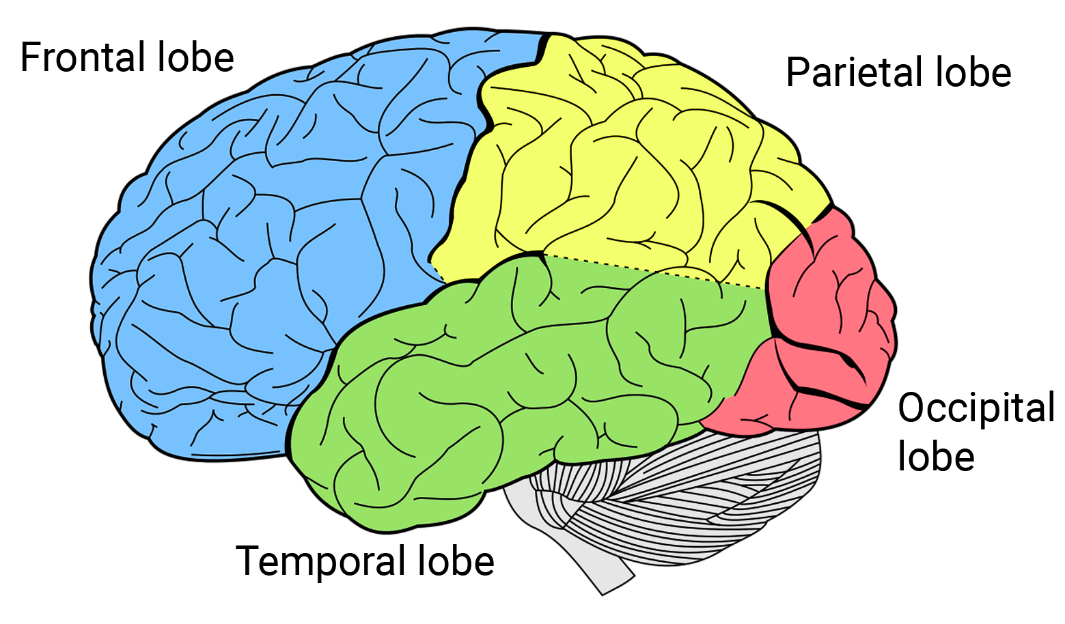
Background Neurobiology: The Brain
Executive functions (planning, reasoning, problem-solving)
Integration of sensory information
Decoding of visual information
Analyses auditory information
Notes:
Starting with the anatomy of the Brain
Central control organ
86 billion nerve / glial cells
Intricate and compact organization –> cauliflower appearance
Obvious separation into 2 Hemispheres (control opposite side of body)
no clear functional separation anywhere

Slide 4
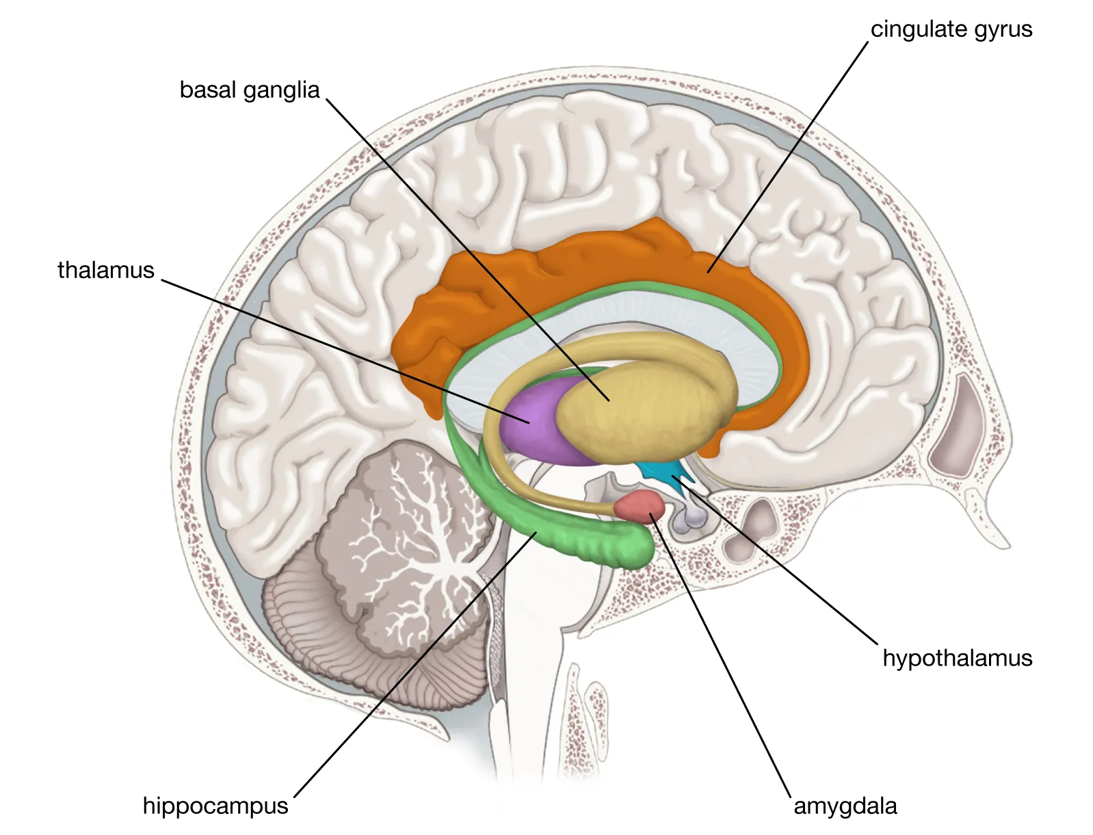
Background Neurobiology: The Brain
The Limbic System
Central control organ
86 billion neurons/glial cells
Responsibilities
Emotional responses
Olfaction
Formation of long-term memory
Hippocampus
Notes:
Now from the inside -> Sagittal section

Slide 5
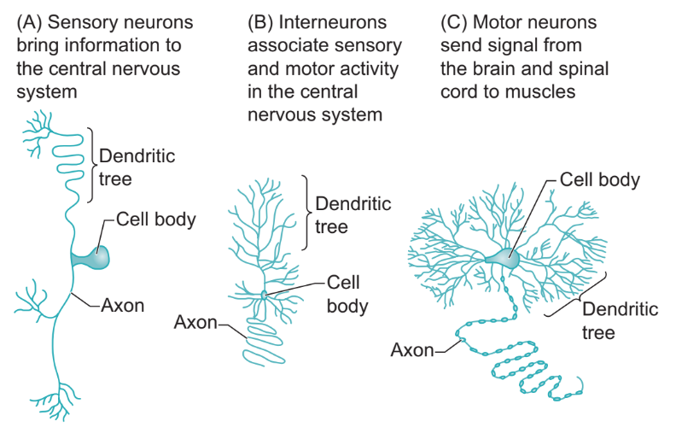
Background Neurobiology: Neurons and Glial Cells
Glial Cells
Supportive function
Neurons
Transmit information
Different shapes and sizes
Key parts
Cell body
Dendrites -> collect input signals
Axons -> deliver output signals
Notes:
Now lets look at what these bigger structures are made of

Slide 6
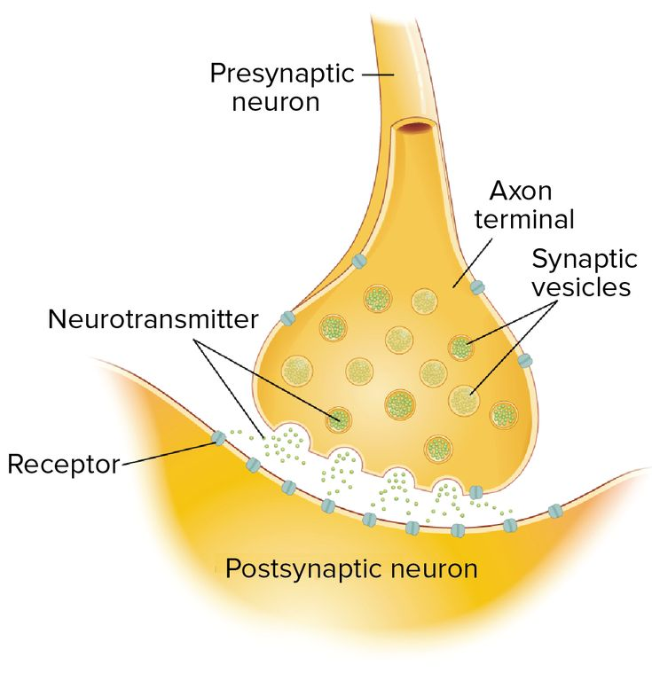
Background Neurobiology: Functionality and Synapses
Communication of neurons
Inside neurons
Electric signals
Between neurons
Often via chemicals
Change in electrical potential
Signal propagation
Circuits
Complex information processing
Incredible functionalities
Notes:
But how do these structures work, you might ask:
And how does all of this produce everything we experience

Slide 7
Background Cognitive Processes, Learning and Memory
Definition
Creating and managing mental representations of information
Attention, reasoning, learning, …
Learning
Allows us to hold on to information
Short & long-term memory
Shapes our behavior
Memory Consolidation
Via the hippocampus
By repeatedly activating certain pathways
Notes:
Speaking of these complex and higher level functions, I now want to look at cognitive processes and one in particular: Learning and Memory

Slide 8

Background Cognitive Warfare
Technological attacks on cognition and mind
Information-based warfare
NeuroStrikes
Propaganda and disinformation
manipulation of beliefs
Direct attacks on the brain
damage and impaired function
Notes:
Broad field of practices and definitions

Slide 9
Background Cognitive Warfare: NeuroStrikes
Havanna Syndrome
Cause still not completely clear
U.S. Embassy of Havanna in 2016
Similar cases arose over the years
Distinct from any previously documented disorder
Symptoms
Acute and sudden onset
Long-term persisting effects
Loud screeching sound, accompanied by pressure and pain in the head
Headache, Dizziness, impaired concentration, memory, and sleep
Underlying mechanism
Pulsed radiofrequency electromagnetic radiation
Notes:
To model such a NeuroStrike as realistic as possible, I first looked for any literature regarding the effects of NeuroStrikes directly

Slide 10
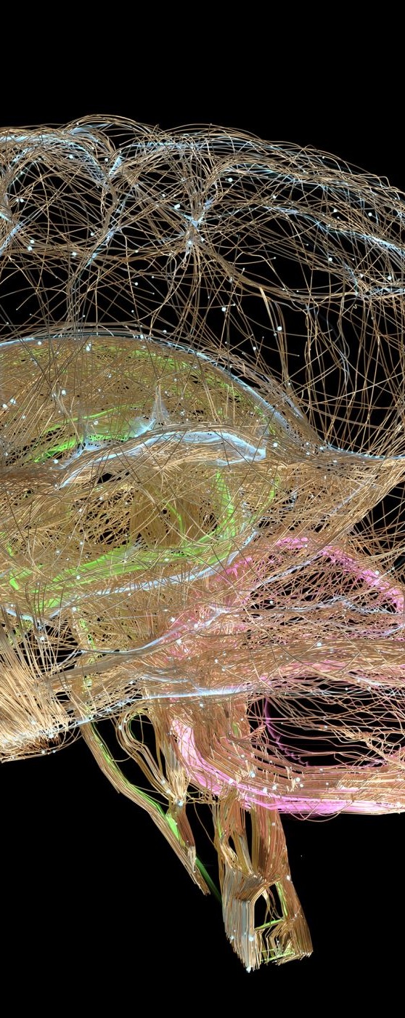
Background Brain-Computer Interfaces (BCI’s)
Enable information transfer between the brain and a Computer
Sensing and interpretation of brain activity
Neural stimulation
Bidirectional systems
Interact with the environment without peripheral nerves and muscles
Enormous potential for
Severely disabled or “locked in” individuals
Entertainment industry

Slide 11
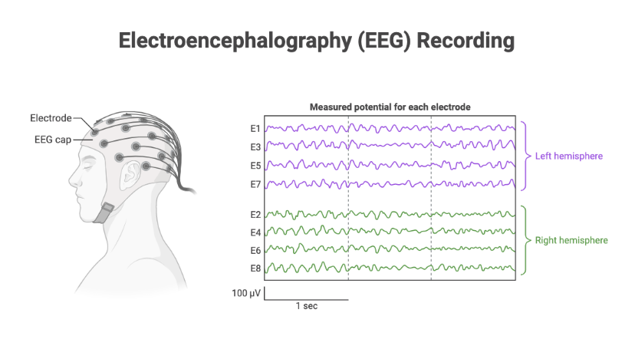
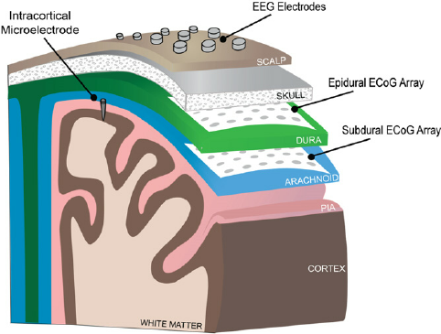
Background Brain-Computer Interfaces
Non-Invasive Examples
Electroencephalography (EEG)
Measures electrophysiological activity
Easy and risk-free application
Poor signal quality
Invasive Example
Intracortical Micro Stimulation (ICMS)
Stimulation of the cortex via small implanted electrodes
Allows manipulation of sensory perceptions
Potential to restore vision or supplement prostheses with tactile perception
Notes:
One of the most popular methods (EEG)

Slide 12
Related Work General Disclaimer
Topic is extremely novel
No directly related work at all can be found
Supplement with literature about
Aspects of my thesis
From different contexts
Subtopics that I explored like this
Realistic simulation of a cognitive Process
Modelling of Electromagnetic Attacks

Slide 13
Related Work Models for the Simulation of Cognitive Processes
Model Name | “A 1000 cell network model for Lateral Amygdala” | “Model of CA1 activity during working memory task” | “Model of the hippocampus over the sleep-wake cycle using Hodgkin-Huxley neurons”
Cognitive Process | Fear conditioning mechanisms | Low level working memory mechanisms | Memory consolidation activity patterns
Attack integration | Many Neuron parameters | Limited Parameter space | Enormous parameter space
Realism | 1000 realistic Neurons | 9-12 realistic Neurons | 33’200 Neurons, anatomically accurate organized
Notes:
I analyzed and compared a few models
Based on:
Meaningful relation to cognitive process in a measurable way
Allow for integration of attacks
Realism
Amygdala -> performace of cognitive process not well measurable
Working memory -> not realistic (to small)
Hippocampus -> fullfills everything
Clear and measurable relation to memory
Good integration of attack via parameter space
Very realistic

Slide 14

Related Work Models for the Simulation of Cognitive Processes
Model Name | “A 1000 cell network model for Lateral Amygdala” | “Model of CA1 activity during working memory task” | “Model of the hippocampus over the sleep-wake cycle using Hodgkin-Huxley neurons”
Cognitive Process | Fear conditioning mechanisms | Low level working memory mechanisms | Memory consolidation activity patterns
Attack integration | Many Neuron parameters | Limited Parameter space | Enormous parameter space
Realism | 1000 realistic Neurons | 9-12 realistic Neurons | 33’200 Neurons, anatomically accurate organized
Notes:
I analyzed and compared a few models
Based on:
Meaningful relation to cognitive process in a measurable way
Allow for integration of attacks
Realism
Amygdala -> performace of cognitive process not well measurable
Working memory -> not realistic (to small)
Hippocampus -> fullfills everything
Clear and measurable relation to memory
Good integration of attack via parameter space
Very realistic

Slide 15
Related Work Models for the Simulation of Cognitive Processes
Model Name | “A 1000 cell network model for Lateral Amygdala” | “Model of CA1 activity during working memory task” | “Model of the hippocampus over the sleep-wake cycle using Hodgkin-Huxley neurons”
Cognitive Process | Fear conditioning mechanisms | Low level working memory mechanisms | Memory consolidation activity patterns
Attack integration | Many Neuron parameters | Limited Parameter space | Enormous parameter space
Realism | 1000 realistic Neurons | 9-12 realistic Neurons | 33’200 Neurons, anatomically accurate organized
Notes:
I analyzed and compared a few models
Based on:
Meaningful relation to cognitive process in a measurable way
Allow for integration of attacks
Realism
Amygdala -> performace of cognitive process not well measurable
Working memory -> not realistic (to small)
Hippocampus -> fullfills everything
Clear and measurable relation to memory
Good integration of attack via parameter space
Very realistic

Slide 16
Related Work Models for the Simulation of Cognitive Processes
Model Name | “A 1000 cell network model for Lateral Amygdala” | “Model of CA1 activity during working memory task” | “Model of the hippocampus over the sleep-wake cycle using Hodgkin-Huxley neurons”
Cognitive Process | Fear conditioning mechanisms | Low level working memory mechanisms | Memory consolidation activity patterns
Attack integration | Many Neuron parameters | Limited Parameter space | Enormous parameter space
Realism | 1000 realistic Neurons | 9-12 realistic Neurons | 33’200 Neurons, anatomically accurate organized
Notes:
I analyzed and compared a few models
Based on:
Meaningful relation to cognitive process in a measurable way
Allow for integration of attacks
Realism
Amygdala -> performace of cognitive process not well measurable
Working memory -> not realistic (to small)
Hippocampus -> fullfills everything
Clear and measurable relation to memory
Good integration of attack via parameter space
Very realistic

Slide 17
Related Work Modeling of Electromagnetic Attacks
Known symptoms, affecting cognitive processes
Impaired concentration, memory, sleep
Reported effects of electromagnetic radiation on the brain
Structural damage to
Hippocampal formation, cerebral cortex, amygdala, …
Neurotransmitter changes
Dopamine, GABA, acetylcholine, Serotonin, …
Potential mechanisms causing memory impairment
Damage to hippocampal formation
Acetylcholine changes
Notes:
Now the symptoms are known, but the underlying mechanisms not so much
Explored literature that was concerned with electromagnetic radiation
To find out what changes in the brain could be responsible for the Symptoms of NeuroStrikes
So I can model the attacks like this

Slide 18
Thesis Goal A Solution based on Brain-Computer Interfaces to mitigate Cognitive Warfare
Specifying research topics
Cognitive warfare as NeuroStrikes
Pulsed radiofrequency electromagnetic radiation
Mitigating effect on cognitive processes
Memory and learning
Based on Brain-Computer interface simulations
Hippocampus model
Overall goal
Explore the underlying mechanisms of NeuroStrikes
Propose a BCI algorithm for the mitigation of their effects

Slide 19
Design General Approach
Planned Progression
Simulate model of hippocampal formation
Validate output of own configuration
Ensuring realistic behavior
Integrate the electromagnetic attack
Based on potential mechanisms identified in related work
Validate the impact on memory
Design a countermeasure algorithm
Respecting the capabilities of BCI’s
Improving the memory performance measurably

Slide 20
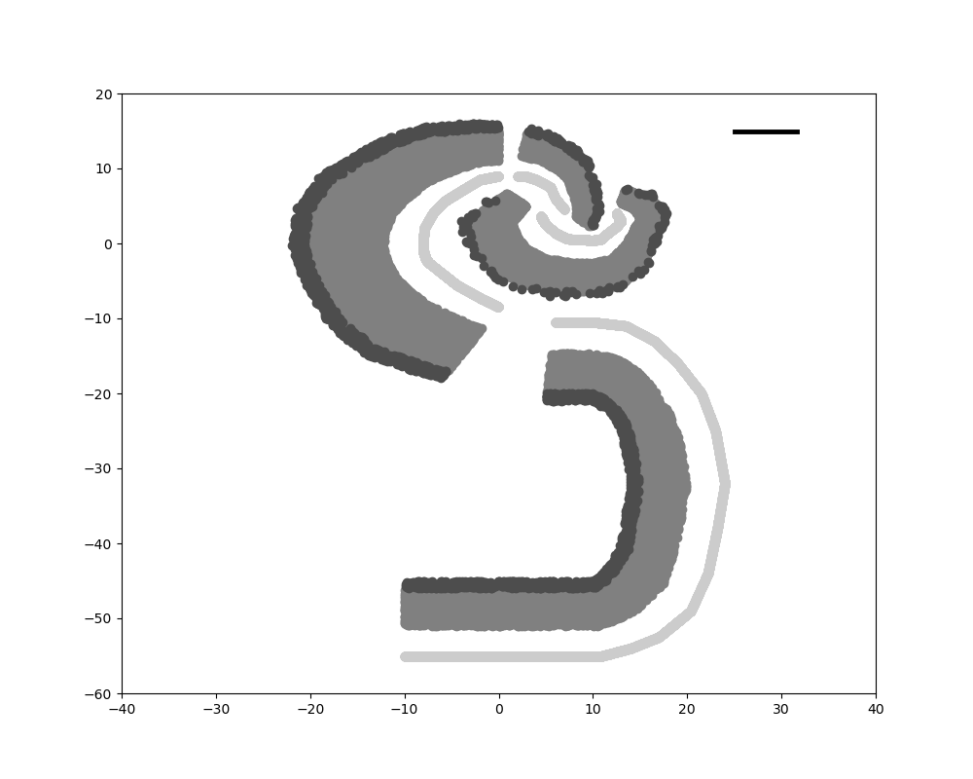
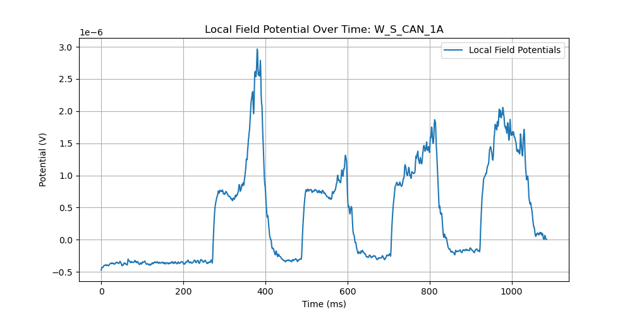
Design Simulator and Model choice
Brian2 simulator
Efficient simulation of spiking neural networks
Written for Python (as a library)
Model of the hippocampal formation
Simulates sleep and wake states
By altering input and network connectivity accordingly
Measurable memory performance via occurrence of activity patterns
Differ depending on sleep/wake status
Provides multiple outputs as standard
Network structure of every run
Voltage readings of a simulated electrode
Specifics regarding the activity patterns
Notes:
One of the most popular methods (EEG)

Slide 21
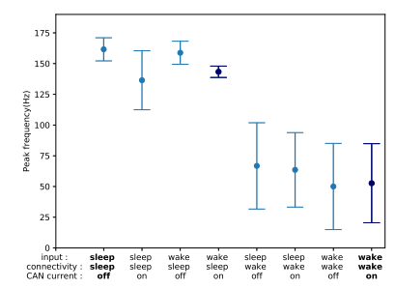
Design Progress and current Status
Originally required EEG files as input (not available)
Realistic event occurrence:

Slide 22
Next Steps Integration of Attack and Countermeasure
Integration of attack
Explore different approaches
Model changes of acetylcholine
Model impact on structure
Validate impact
Compare to expected changes
Ensure relation to cognitive Process
Design countermeasure
Integrate BCI in the simulation
Create multiple algorithms
Measure efficacy
Select the best one
Utilizing different methods
Optimize simulation
Waking input
Create realistic sleep input
Solve issues during sleep connectivity
Based on correct waking one

Slide 23

Questions

